Slide 1
Battle of Neighborhoods
Seattle, Washington
BY
Jayashri Muralidharan

Slide 2
Problem Statement
Select the best neighborhood to live, to buy a house or to build a restaurant etc in Seattle, Washington .
Understanding the similarities and differences between the neighborhoods using Unsupervised K-Mean Clustering Algorithm

Slide 3
Objective
Collecting Neighborhood’s top trending venues using Foursquare API(Beautiful Soup, http request)
Forming neighborhood clusters based on venue categories using unsupervised k-mean clustering algorithm(sklearn)
Identifying and understanding the similarities and differences between two chosen neighborhoods to retrieve more insights and to conclude with ease which neighborhood wins over other.

Slide 4
Python packages and Dependencies:
Pandas - Library for Data Analysis
NumPy – Library to handle data in a vectorized manner
JSON – Library to handle JSON files
Geopy – To retrieve Location Data
Requests – Library to handle http requests
Matplotlib – Python Plotting Module
Sklearn – Python machine learning Library
Folium – Map rendering Library

Slide 5
Work flow
Web Scraping and Data Wrangling
Top Trending Places Extraction and Clustering
Decision Making based on the clustered neighborhoods, Population Distribution, School Ratings, Median House Price Analysis

Slide 6
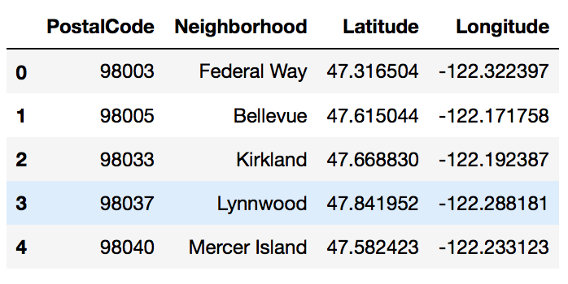

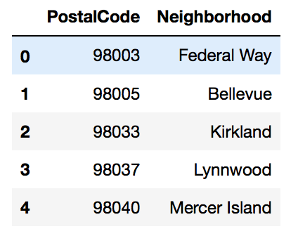
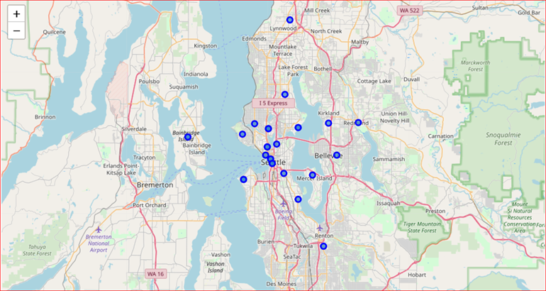
Web Scraping and Data Wrangling
Beautiful Soup
Google Maps API
Collecting Neighborhood/Postal code
http://seattlearea.com/zip-codes/
To Collect Geographical Data
Folium Visualization for Seattle Neighborhood

Slide 7

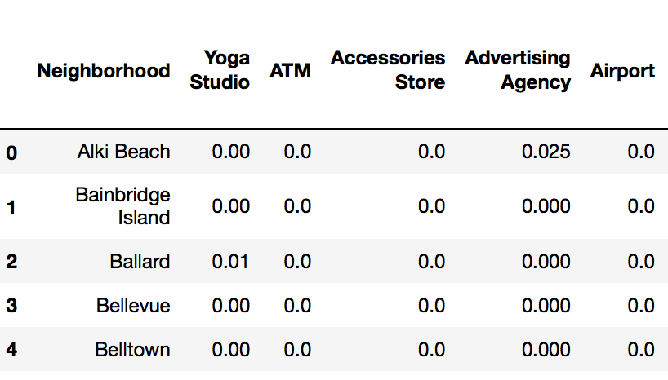
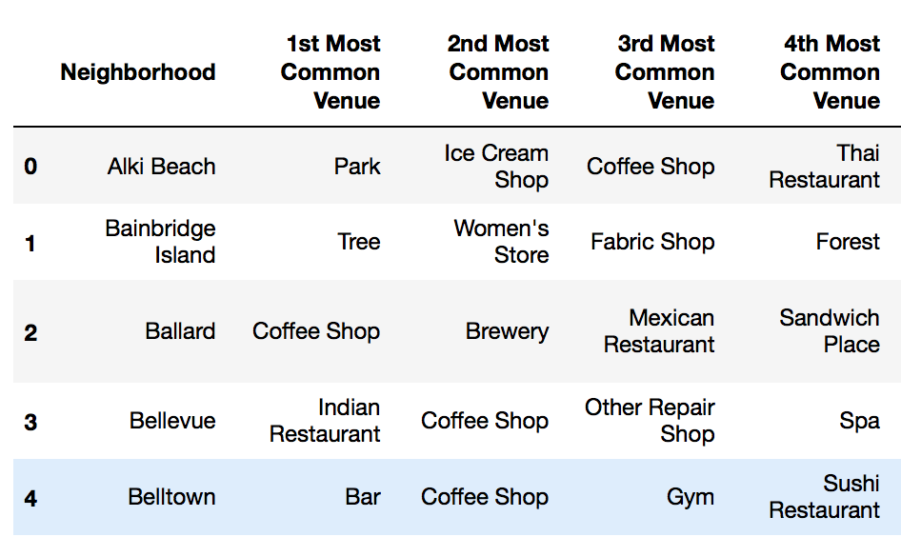
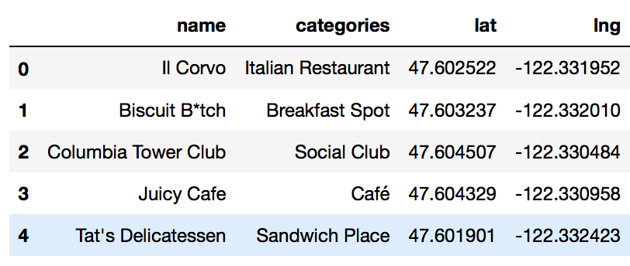
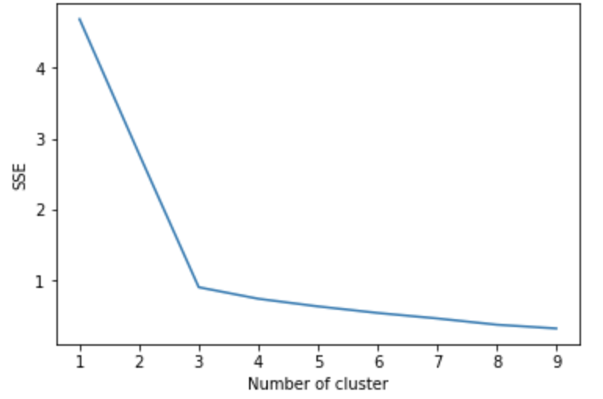
Venues Extraction using Four Square API and Clustering
Four Square API Calls to Collect Neighborhood Venue Category and LAT/LNG
Venues Grouped by Neighborhood 229 Unique Venues
Cluster 1
One Hot Encoding to Convert Labels into Numbers
K-Means Clustering
Cluster 2
Silhouette Score
Elbow Method
Cluster 3

Slide 8
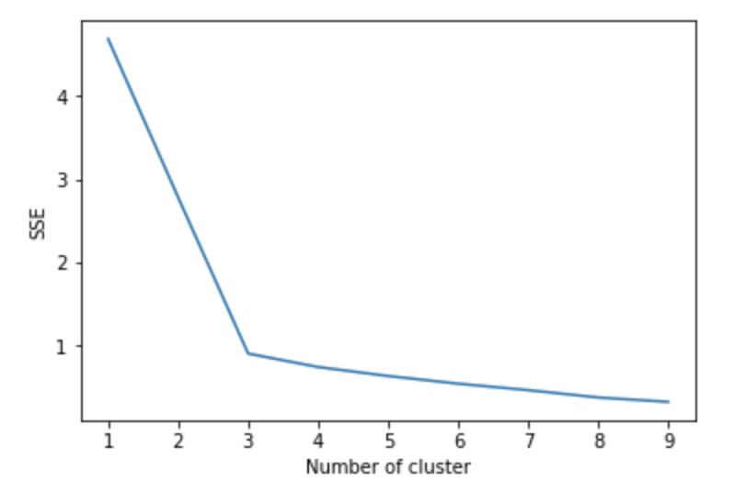
Elbow Criterion Method
The idea behind elbow method is to run k-means clustering on a given dataset for a range of values of k and for each value of k, calculate sum of squared errors (SSE). After that, plot a line graph of the SSE for each value of k.

Slide 9
sklearn.metrics.silhouette_score
The Silhouette Coefficient is calculated using the
mean intra-cluster distance (a) and
the mean nearest-cluster distance (b) for each sample.
The Silhouette Coefficient for a sample is (b - a) / max(a, b).
The best value is 1 and the worst value is -1. Values near 0 indicate overlapping clusters. Negative values generally indicate that a sample has been assigned to the wrong cluster, as a different cluster is more similar.

Slide 10
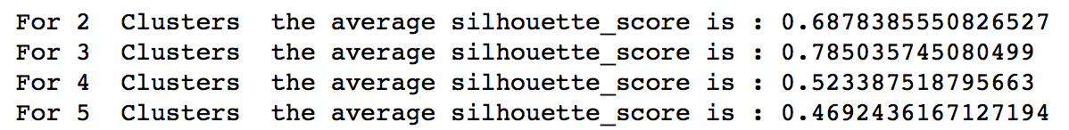
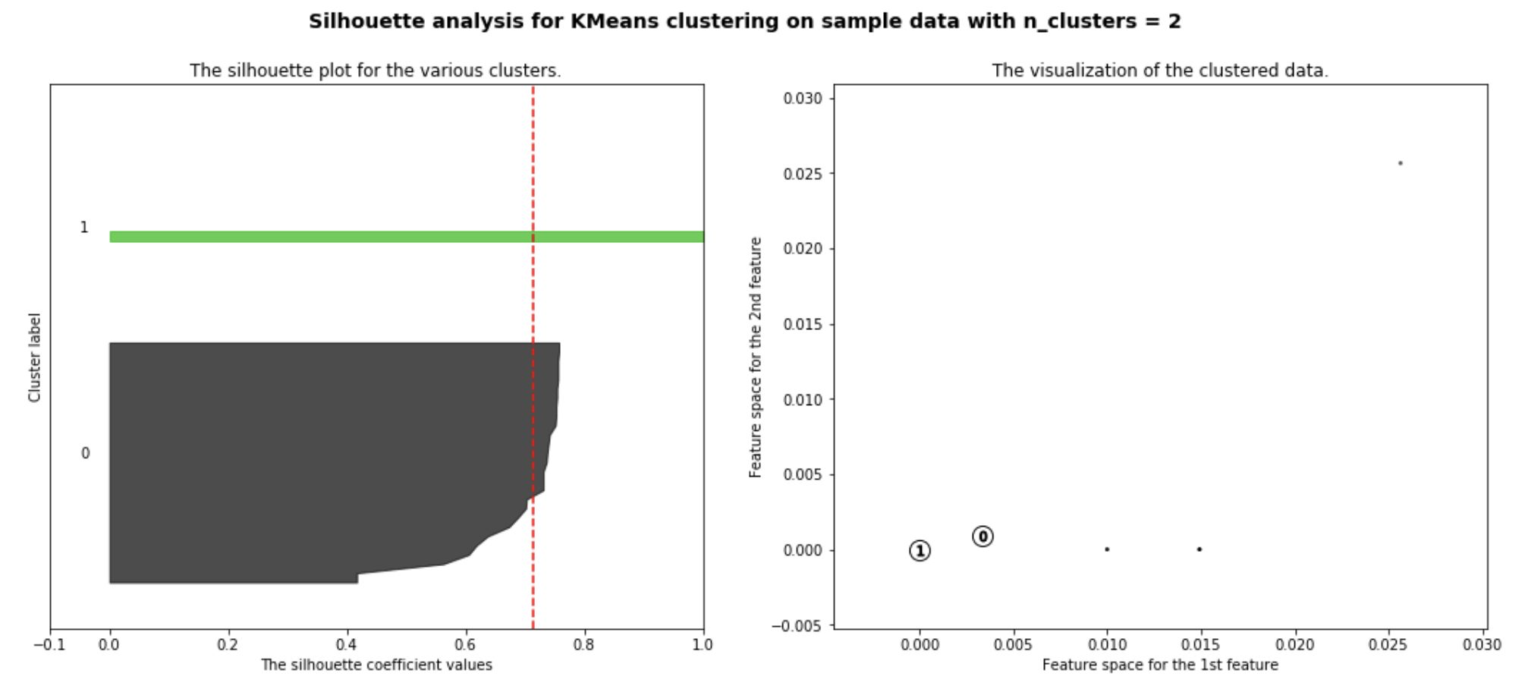
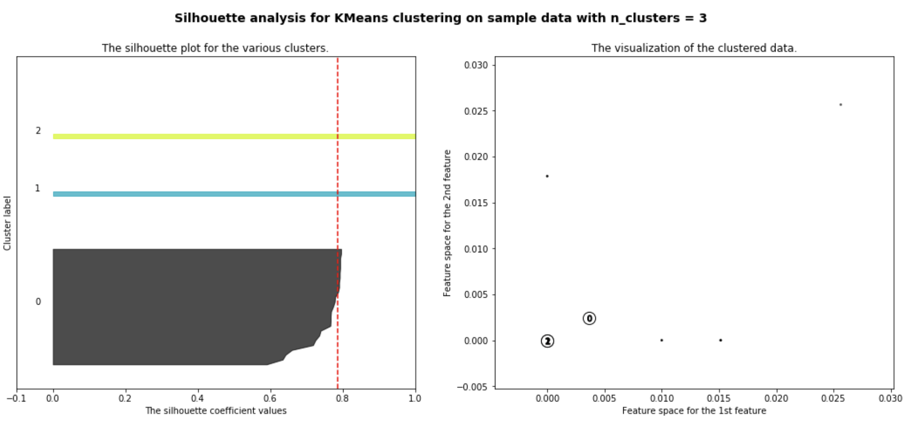
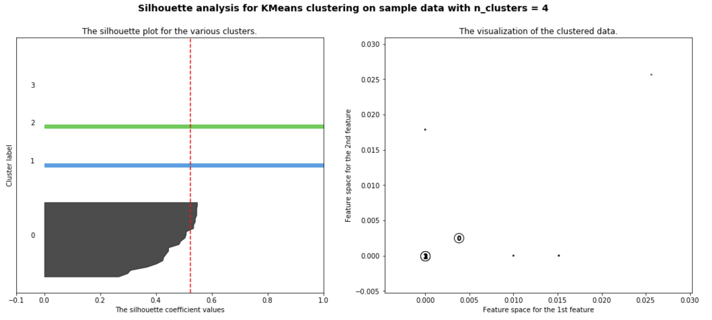
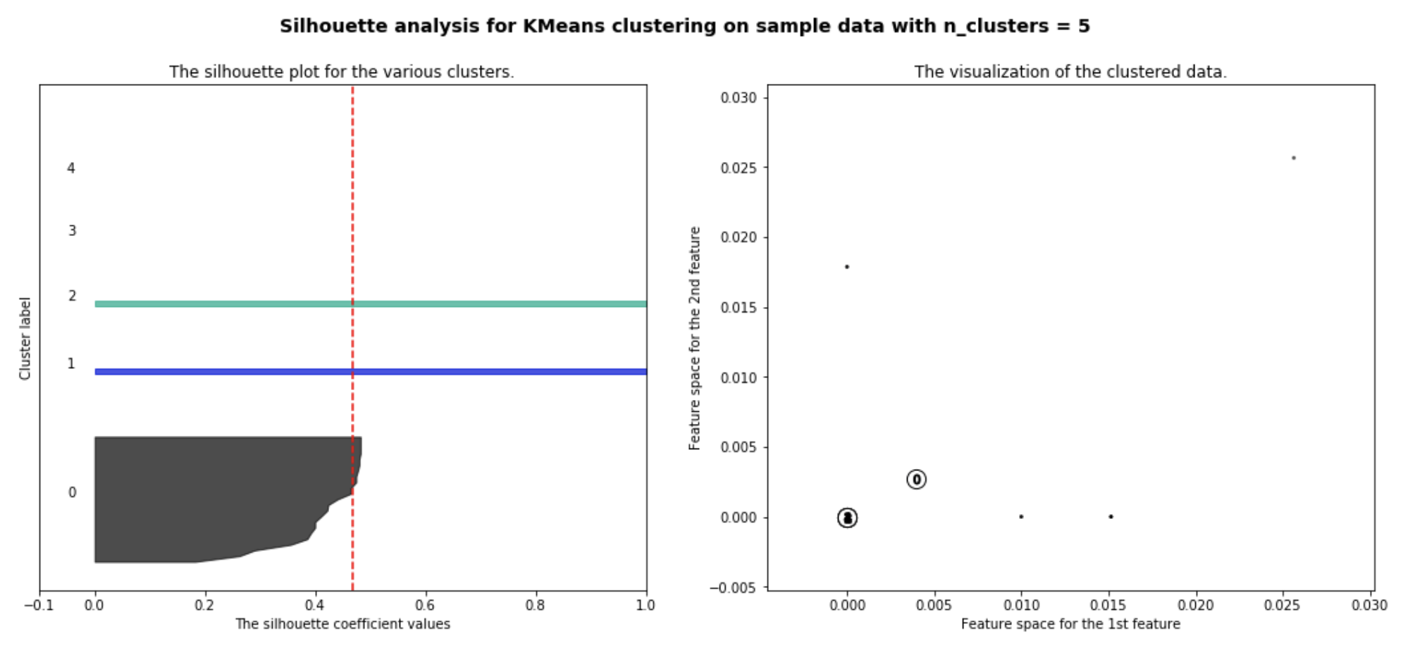
Siluhouette Score and Cluster Visualizations

Slide 11
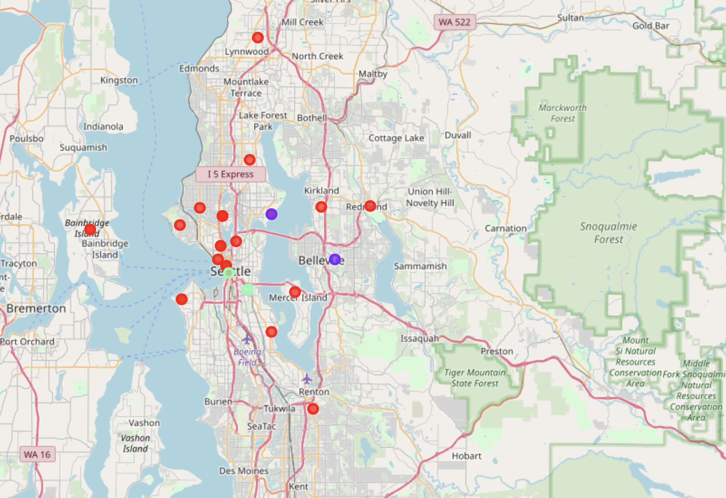
Neighborhood Clusters

Slide 12








Neighborhood 1
Neighborhood 2
Decision Making
Population Distribution Analysis
Median House Price Analysis
School Ratings Analysis
Cluster Analysis
Winning Neighborhood

Slide 13
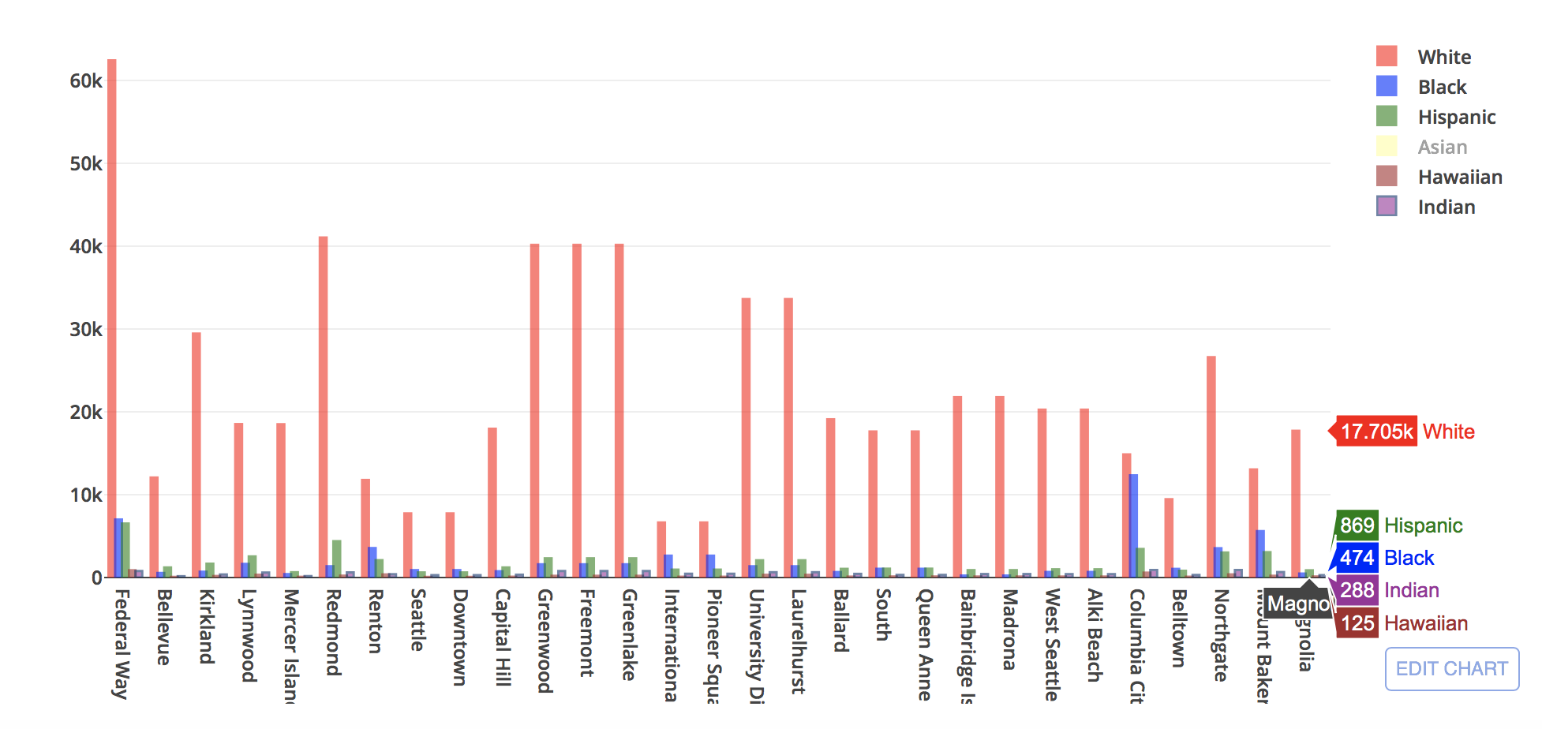
POPULATION DISTRIBUTION

Slide 14
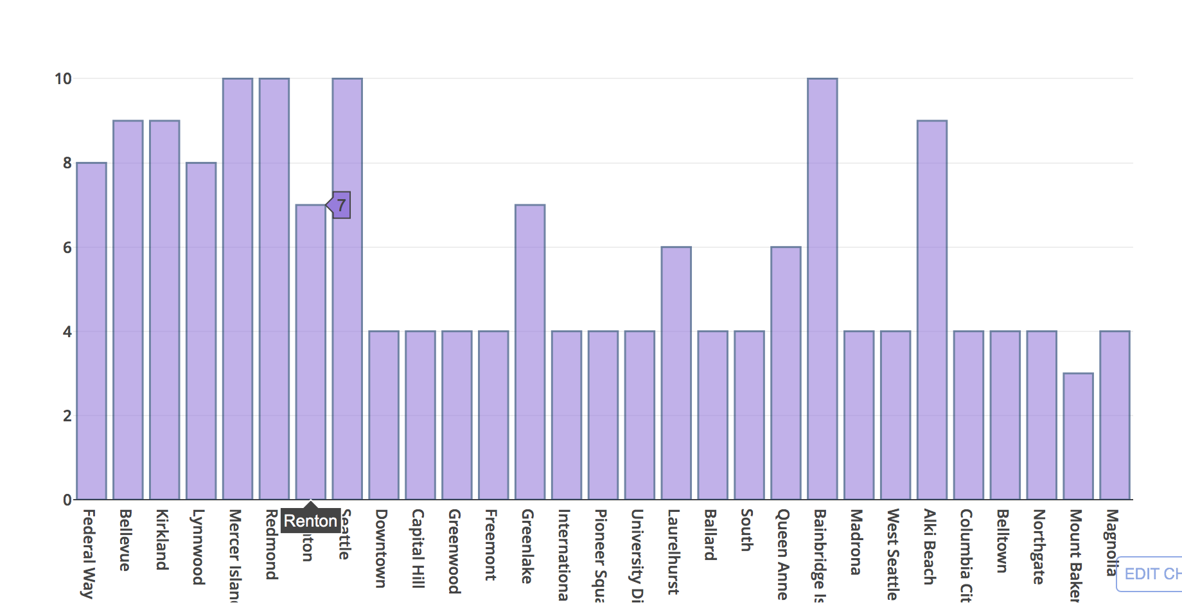
AVERAGE SCHOOL RATINGS

Slide 15
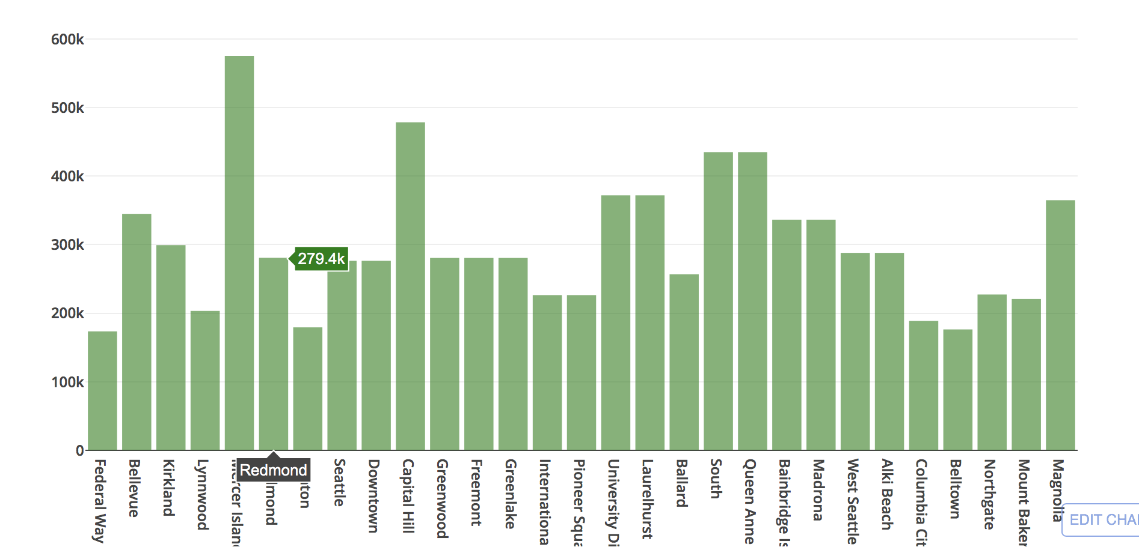
MEDIAN HOUSE PRICE

Slide 16
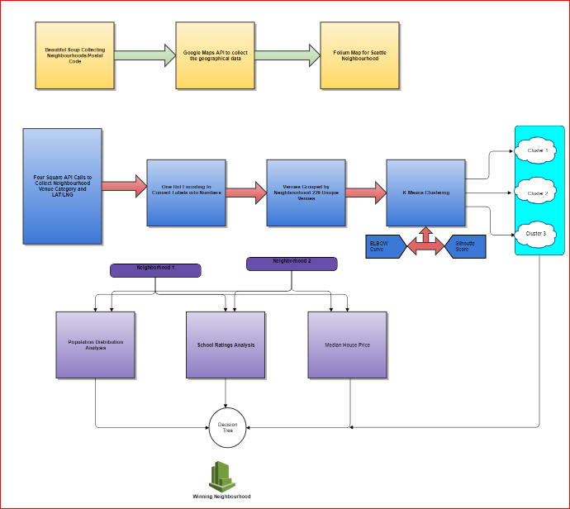
Complete Workflow

Slide 17
Comparison between Neighborhoods
Bellevue and Kirkland
Now lets compare 2 neighborhoods to choose one that best matches our requirements as given below
1. More Indian Population
2. Higher School Rating
3. Reasonable Housing Price in the Range of 300k to 500k
4. Comfortable Neighborhoods

Slide 18
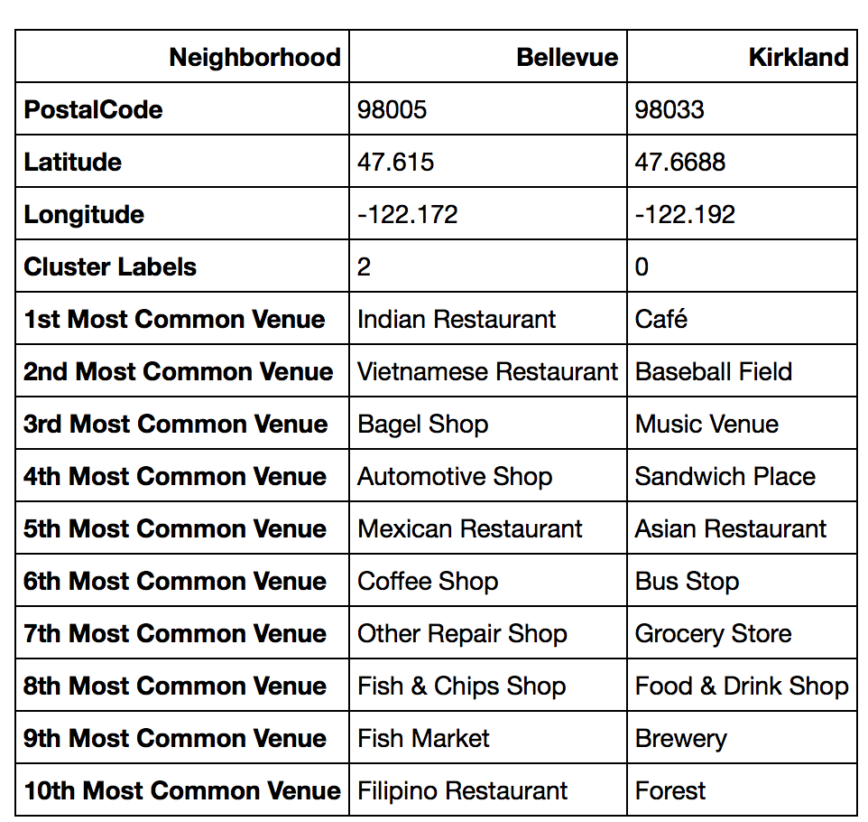
Neighborhood Venues

Slide 19
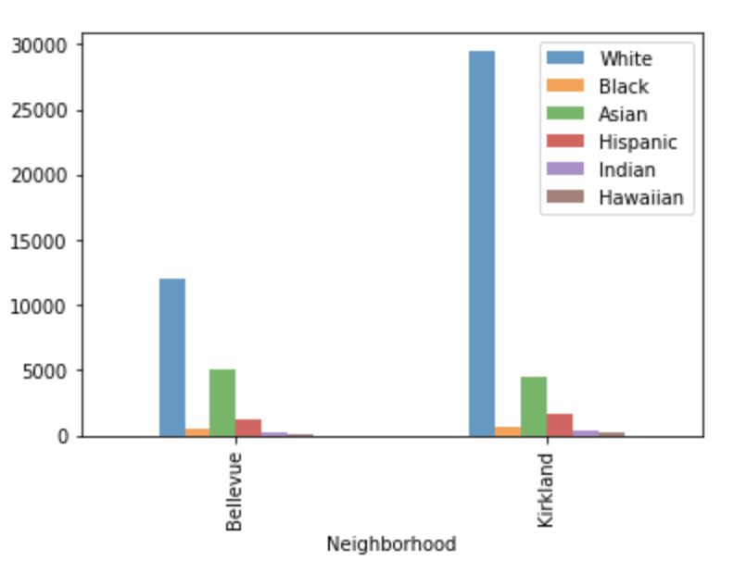
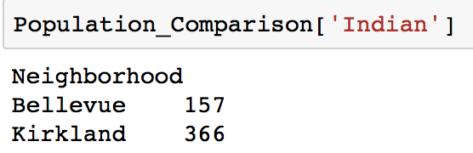
Population distribution

Slide 20
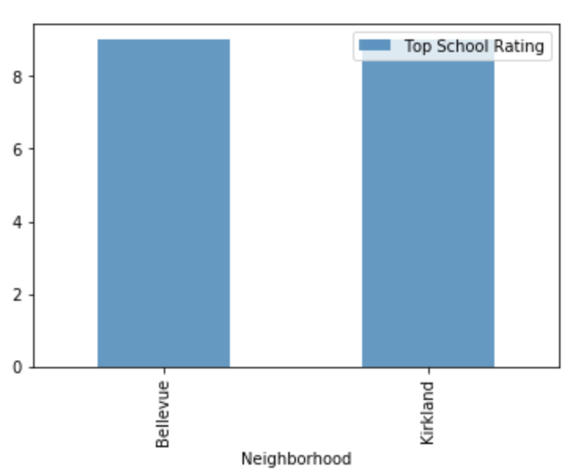
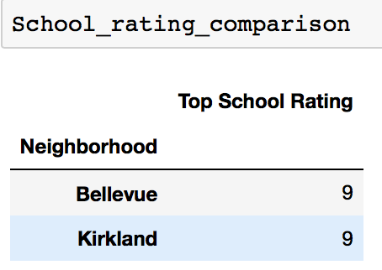
School ratings

Slide 21
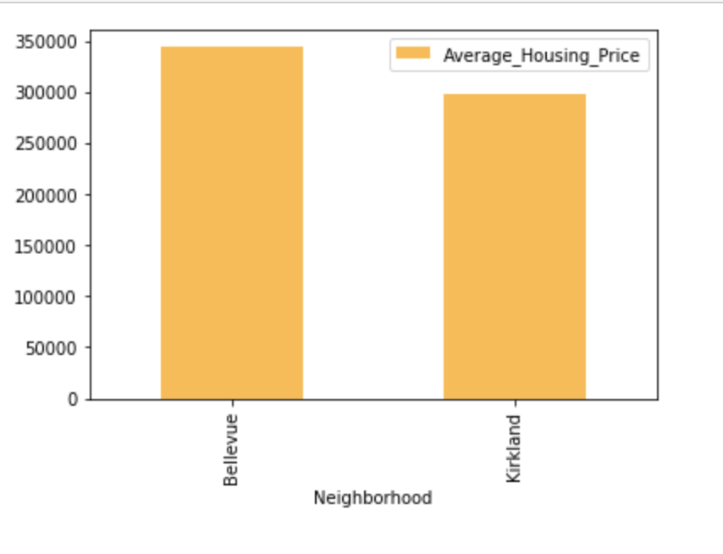
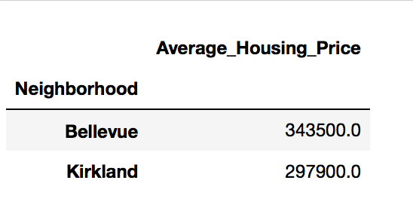
Average housing price

Slide 22
conclusion
This Analysis concludes that compared to Bellevue ,
Kirkland has the higher number of Indian population
Good school rating of 9
Reasonable average housing price of approximately 300k
Top 10 common venues shows Kirkland has gotten a good neighborhood with Cafe, Restaurants, Sandwich Place, Baseball Field etc.
Hence Kirkland wins over Bellevue!

Slide 23
Thank you

